Slide 1
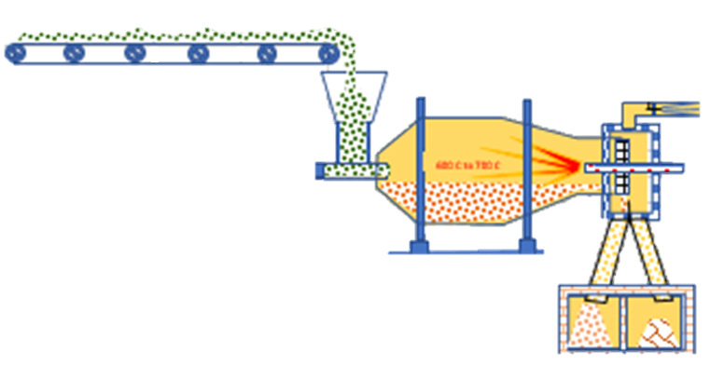
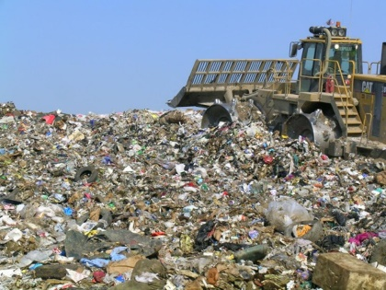
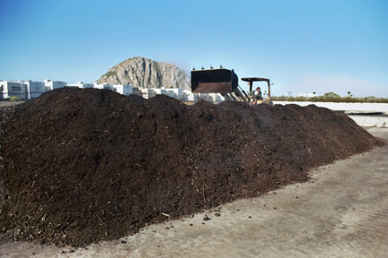
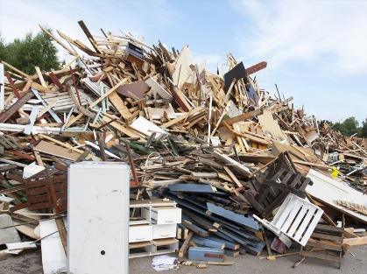
RELIANCE ENERGY SYSTEM
Gasification Of Any Waste Train:
Agriculture, MSW, Sludge & Bio-Solids, Construction Waste, etc.

Slide 2
Agenda
Background
Process Fundamentals
Commercial Status
Energy Balances
Gasification Relative to Today’s Issues
Summary
2

Slide 3
Background – History of Gasification
Charcoal formation (pyrolysis)
Several thousand years old
Gasification
Large scale use on coal in the 1800’s; wood in 1900’s
New focus → alternative feedstocks
EPA, U.S. (2012). Technology Assessment Report: Aqueous Sludge Gasification Technologies.
3

Slide 4
Process Fundamentals
General Steps
Drying
Combustion (oxidation)
Gasification (reduction)
Main Types of Gasifiers
Fixed bed
Rotating Fluidized bed
Tars H₂ CH₄
Heat
Carbon Feedstock
Char
Pyrolysis Reactions
4

Slide 5
Reaction Pathways
Combustion (Oxidation) Reactions
Gasification (Reduction) Reactions

Slide 6
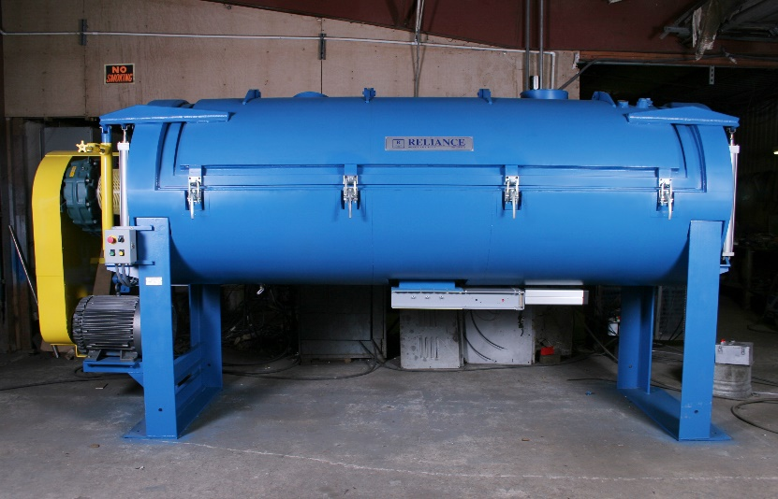
Feedstock Heating Methods
Combustion:
Char + Limited O₂ → CO₂ + CO + H₂O + Heat
Heater Source:
FEEDSTOCK W/MOISTURE>20%
FEEDSTOCK W/ DESIRED MOISTURE CONTENT
Plasma Torch (Westinghouse)

Slide 7
Feedstock Properties
Proximate Analysis of Various Waste Train Feedstocks
Parameter | MSW | Bio-Solids | Agriculture Waste | Construction Waste
Ash, % |  | 40-50
Volatile, % |  | 40-50
Fixed C, % |  | 5-10
HHV, Btu/lb Sources: 1. Stamford Waste to | Energy Draft Report; 2. Gikas et al., 2 | 3000-5500 011
9

Slide 8
Syngas Properties
Energy Content of Syngas, Biogas and Natural Gas
100-130 Btu/ft³ typical (air-blown)
Biogas ~550 Btu/ft³
Natural gas ~950 Btu/ft³
Primarily CO and H₂
Usually highly diluted with N₂
Syngas conditioning required for use in a gas engine
Thermal oxidation of syngas avoids gas cleaning
Example Syngas Composition (v/v)
Hydrogen = 9%
Carbon monoxide = 14%
Carbon dioxide = 20% Methane = 7%
Nitrogen = 50%
10

Slide 9
Gasification vs. Incineration
Gasification
Incineration
Drying required as • Drying not required as pretreatment step pretreatment step
Designed to maximize • Designed to maximize
feedstock conversion to CO and H₂
feedstock conversion to CO₂ and H₂0
Reducing environment
Limited oxygen
Highly oxidizing environment
Excess air

Slide 10
Biosolids Gasification Configurations
Close-Coupled Gasification
No syngas cleaning
Syngas thermally oxidized
Heat recovery and/or power generation from flue gas
Excess Energy
Wet Sludge
Main Energy Sink
Syngas Utilization
Dewatering
Drying
Gasification
Energy for Drying

Slide 11
Limited O₂
AND /Or
CLOSE COUPLED GASIFICATION
External Heat
Dried Sludge
Excess O₂
Process Heat
Syngas
Thermal Oxidation
Flue Gas Treatment
Gasification
Stack
Metal Granules Coated
with Silica

Slide 12
Process Diagram for Kopf Gasification Plant

Slide 13
Staffing Requirements
Sanford facility staffing requirements
6 full-time operators
Plant manager and administrator
Owned and operated by MaxWest
Now offering gasification equipment as capital sale
Typical installed cost in the range of $7-10M
20

Slide 14
Syngas from “Fresh Solids”
Rotary Fabric Fine Screen
Trials with solids from Adelanto, CA WWTP
January and June of 2010
Syngas properties
• CO = 31.5%
• H₂ = 49.2%
• CH₄ = 7.73%
• CO₂ = 3.20%
8.83% “unidentified gases”
UHT Gasifier
Gikas et al., 2011

Slide 15
Stamford, CT Waste to Energy Project
High electricity costs
• $0.18/kwh
City identified need for up to 15 MW additional power
Proposed gasification system to generate electricity
25 tpd (dry) facility
Produce 1-3 MW of electricity from syngas
2007 - Thermal drying facility constructed
Pilot gasification facility
Trailer mounted fixed-bed updraft gasifier (0.53 tpd)
2008 to 2009 - Full-scale trials with three vendors
Primenergy, Nexterra, Kopf

Slide 16
Stamford Pilot Gasifier
Fixed-bed Updraft Reactor
Gasification pilot donated to UCONN for research in March 2012…
Trailer Mounted Gasification Pilot
www.stamfordbiogas.com/Kappe%20Gasification%20for%20SF.pdfSimilar
24

Slide 17
Stamford/Nexterra Current Status
“The public balked at the project's $40 million price tag, and the WPCA board voted to kill the venture in early 2010 after losing faith in its technical and economic feasibility.”
Read more: http://www.stamfordadvocate.com/news/article/ Waste-to-energy-remnant-donated-to-
UConn-3431002.php#ixzz2AAK4RDIv
25

Slide 18
Energy Balance Considerations
Net Energy = Energy Outputs – Energy Inputs
Main energy outputs
Electric power
Heat
Main energy inputs (parasitic loads)
Dryer
Blowers
Gasifier startup
Gasifier external energy needs
Induction heater, plasma torch, etc.
Syngas cleanup
Courtesy of Huber
26

Slide 19
Power Generation Options
Fuel cells – not currently used with syngas
Gas turbines – require minimum heating value of 450 Btu/ft³ and pressurization of syngas
Internal combustion engines – possible
Requires minimum heating value of ~140 Btu/ft³
Still may need to blend with natural gas
Blended Gas
Syngas
Electric Power
Gas Engine
Engine Exhaust Heat Recovery
Natural Gas (if needed)
Engine Cooling Jacket Heat Recovery
27

Slide 20
Energy Required for Drying
Thermodynamics
Typically 1,400-1,700 Btu/lb of water evaporated
Heat sources:
Natural gas, methane, propane, electric power
Recovered heat, waste heat
Solar
25 dtpd gasification + thermal oxidation system could yield
approx. 8-10 MMBtu/hr
For a 25 dtpd drying facility:
Energy Required (MMBtu/hr)
Natural Gas Cost ($/yr)
Power Cost ($/yr)
Scenario
15% Solids Feed
17.4
$1,181,000
$2,006,000
20% Solids Feed
12.2
$827,000
$1,404,000
25% Solids Feed 9.0
$614,000
$1,043,000
Assumes 1,500 Btu/lb water evaporated, 90% dry solids product, natural gas = 1,030 Btu/cf, natural gas =$8/1000-cf, power = $0.045/kWh
28

Slide 21
Energy Balances Presented in Literature
5 tpd two-stage gasification system (~4-6 mgd WWTP)
Energy balances NOT from actual full-scale operation
Air-Blown Gasifier ¹ M2R/Pyromex Gasifier ²
Net output = 165 kW
Assumptions:
Net output = 295 kW
Assumptions:
Syngas HHV = 190 Btu/ft³
System parasitic load = 75 kW
Biosolids dried to 90% solids
Syngas HHV = 338 Btu/ft³
System parasitic load = 116 kW
Biosolids dried to 78% solids
M2R also presented energy balances in recent paper for a hypothetical 20 mgd WWTP (Noll, 2012)
Claimed net electrical energy output of nearly 2:1 vs. anaerobic digestion
1. Source: US EPA, 2012; 2. Source: M2R Thermal Energy Conversion Brochure

Slide 22
Energy Balances Presented in Literature
From Stamford Waste to Energy project report:
Biosolids feed rate = 3,695 lb/hr
Syngas production rate = 2,595 scfm
Syngas LHV = 117 Btu/scf
Quantity of syngas = 84,287 scf/ton-biosolids
Cold gas efficiency = 69.4%
Gross electric power production = 1,869 kW
Net electric power production = 1,623 kW
Proposed facility footprint of 140’x100’
Project killed due to cost and technical feasibility

Slide 23
Energy Balances from Operating Facilities
Kopf – Balingen plant
Digested sludge
Equivalent to approx. 7.2 mgd
Original plant used solar drying
Produced ~70 kW of electric power
15 kW needed for parasitic loads
~55 kW net
Produced ~140 kW of thermal energy
Used to heat digesters at the WWTP
Rebuilt in 2006 – added belt dryer
Most of the gas now used for heating the belt dryer
Courtesy of Kopf
31

Slide 24
Energy Balances from Operating Facilities
MaxWest facility in Sanford, FL
Main goal is an energy-neutral system
Current input to dryer is 16% solids
Needs to be dried to 90% solids
Current system requires natural gas supplement for dryer
According to MaxWest, achieving energy-neutral requires:
23-25% solids feed depending on ratio of primary/secondary sludge

Slide 25
Economics of Two-Stage Sludge Gasification
Economics largely dependent on electricity cost
Renewable energy tariff
National Average Wholesale Electricity Rate
New England Average Industrial Electricity Rate + RE Tariff ($0.0435/kWh)
Case
Electricity Cost, $/kWh
$0.042
$0.093
Tipping Fee, $/DT
$70
$70
Annual Operating Revenue, $
$41,624
$61,742
Annual Operating Cost, $
($36,995)
($41,551)
Capital Costs, $
($269,815)
($269,815)
CAPEX per kW, $/kW
$4,652
$4,652
Payback Years 21
Costs presented in USD per dry ton per day operating capacity; source: US EPA, 2012
7

Slide 26
Air Emissions Regulatory Requirements
Currently no specific EPA regulations
Case by case basis
May be classified as incinerators
Criteria air pollutants
Sulfur oxides (SOx)
Carbon monoxide (CO)
Nitrogen oxides (NOx)
Particulate Matter (PM)
Hazardous air pollutants
Hydrogen chloride (HCl)
Dioxins and furans (chlorinated organics)

Slide 27
Air Emissions Data
Emission Limits in 40 CFR Part 60 – Final Rule for SSIs
Pollutant | Units | Existing FB SSIs | New FB SSIs | MaxWest Gen #1 ¹ | MaxWest Gen #2 ²
Cadmium (Cd) | mg/dscm | 0.0016 | 0.0011 | 0.0000723 | -
Carbon Monoxide (CO) | ppmvd | 64 | 27 | 7.87 | 16.1
Hydrogen Chloride (HCl) | ppmvd | 0.51 | 0.24 | 1.8 | 0.321
Mercury (Hg) | mg/dscm | 0.037 | 0.0010 | 0.00798 | -
Oxides of Nitrogen (NO_{x}) | ppmvd | 150 | 30 | 432.17 | 15.4
Lead (Pb) | mg/dscm | 0.0074 | 0.00062 | 0.000819 | -
Dioxins/Furans | ng/dscm | 0.10 | 0.0044 | 0.0285 | -
Particulate Matter (PM) | mg/dscm | 18 | 9.6 | 9.6 | 8.23
Sulfur Dioxide (SO₂) | ppmvd | 15 | 5.3 | 4.17 | 0.0
Source: US EPA, 2012
Source: data provided by MaxWest

Slide 28
Gasification Relative to Today’s Issues
Regrowth/Reactivation
+ Pathogens destroyed
+ No biosolids to dispose of
Resource Recovery
+ POTENTIAL P recovery from ash
No N recovery
Process Reliability
Four full-scale installations worldwide
One full-scale installation in North America
Energy
? Potential for energy generation (depends on syngas quality)
- Drying required as a pretreatment step
- Heat recovery mostly used for drying
Emissions
+ Reduced relative to incineration
+ Lower air requirements
+ Reducing environment

Slide 29
Be Aware of the Process Cycle History…
Third Generation, Mature Technology
Development / No. Installed
Anaerobic Digestion
Incineration Second Generation
Biosolids Drying First Demo
Thermal Hydrolysis
Biosolids Gasification
SCWO
Time
First Pilot
First Applications

Slide 30
Questions?
Courtesy of Nexterra
Thank You!
Courtesy of Kopf
38

Slide 31
References
Judex, J., Gaiffi, M., Burgbacher, H. (2012). Gasification of dried sewage sludge: Status of the demonstration and the pilot plant. Waste Management, 32 (4), 719-723.
Gikas, P., Noll, S., Stedman, K. “Gasification of Primary Fine-Screened Solids for Energy Production,” Eurasia Waste Management Symposium, Halic Congress Center, Istanbul, Turkey, November 14-16, 2011.
Mountouris, A., Voutsas, E., Tassios, D. (2008). Plasma gasification of sewage sludge: Process development and energy optimization. Energy Conversion and Management , 49 (8), 2264-2271.
EPA, U.S. (2012). Technology Assessment Report: Aqueous Sludge Gasification Technologies. U.S. Environmental Protection Agency.
Noll, S. (2012). A Net Energy Comparison of Anaerobic Digestion vs. Ultra-High Temperature Gasification to Achieve Zero Energy, WEF Residuals and Biosolids 2012.
Li-ping, X., Tao, L., Jian-dong, G., Xue-ning, F., Xia, W., Yuan-guang, J. (2010). Effect of moisture content in sewage sludge on air gasification. J Fuel Chem Technol , 38 (5), 615-620.
39

